Slide 1
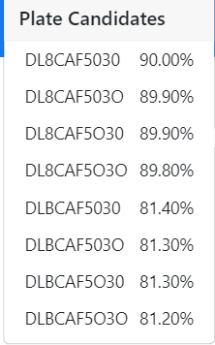
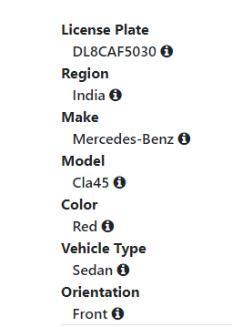
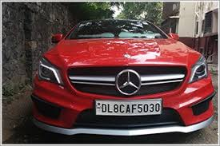
Number Plate: DL 8 CAF 5030
OWNER NAME: Sachin Kapoor
REGISTER RTO: Wazirpur, Delhi
MODEL : MERCEDES-BENZ INDIA PVT LTD, CLA 45 AMG
VEHICLE CLASS: Motor Car(LMV)
FUEL TYPE: Petrol
FUEL NORMS: Bharat Stage IV
ENGINE NO.: 133980800XXXXX
REGISTRATION DATES:13-JUN-2014
VEHICLE AGE: 8 YEARS
INSURANCE EXPIRY: 19-MAR-2023
COLOUR: P JUPITER RED
NUMBER OF SEATS: 5
RC STATUS: Active.

